Slide 1


NextHome
Created by Group No. 10
Alpesh Chandankhede (250843020011)
Raj Kumar (250843020074)
Saksham Pandey (250843020082)
Suraj Patil (250843020101)
Mentor :
Mr. Pratik Kamble

Slide 2
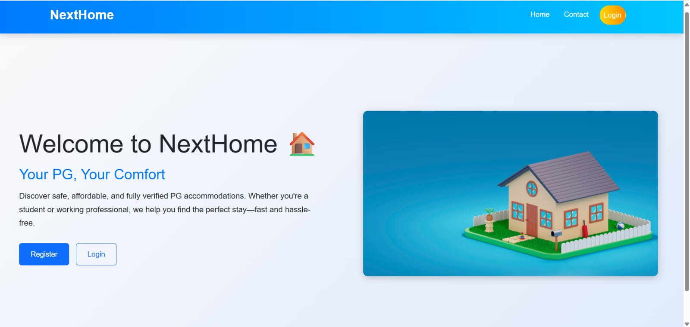
Nexthome

Slide 3
What is NextHome ?
NextHome is a smart, web-based PG and hostel renting system designed to simplify accommodation search and management for students and working professionals. It provides a centralized and transparent platform that connects tenants, PG owners, and administrators for a seamless renting experience.
1
2
3
Smart Search
Online Booking
Trusted Platform
Verified owners, reviews, and complaints ensure transparency and trust.
Book rooms, make payments, and manage rentals digitally
Verified owners, reviews, and complaints ensure transparency and trust.

Slide 4
Why NextHome ?
NextHome solves the key challenges of traditional PG and hostel renting by providing a fast, transparent, and fully digital platform. It simplifies accommodation search, booking, and management for tenants, enables efficient property management for PG owners, and ensures better control and monitoring through an admin-managed system.
1
2
3
Centralized Platform
Efficient Management
Secure & Reliable
All PG and hostel listings, bookings, and details in one place.
Owners can manage PGs, rooms, and tenants digitally with ease.
Role-based access, verified users, and secure transactions.

Slide 5
System Users
NextHome is designed as a role-based system that supports multiple types of users. Each user has specific responsibilities and
access rights to ensure smooth operation, security, and transparency across the platform.
Admin
PG Owner
Tenant
Manage the entire system, approves
PG owners, manages complaints, and
ensures platform integrity.
Registers and manages PG properties rooms, facilities, tenants, and booking requests.
Searches for PGs, views details, books rooms, makes payments and provides feedback.

Slide 6
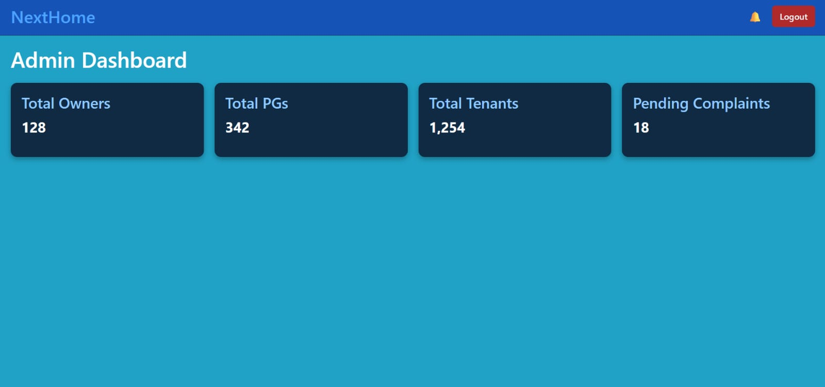
Admin Module
The Admin module acts as the central control system of NextHome. It allows administrators to monitor platform activities, manage users, and ensure smooth and secure system operations..
Key Responsibilities
Approve or reject PG owner registration requests
Monitor total PGs, owners, and tenants
View and manage booking details
Handle complaints and feedback
Track room availability across the platform

Slide 7
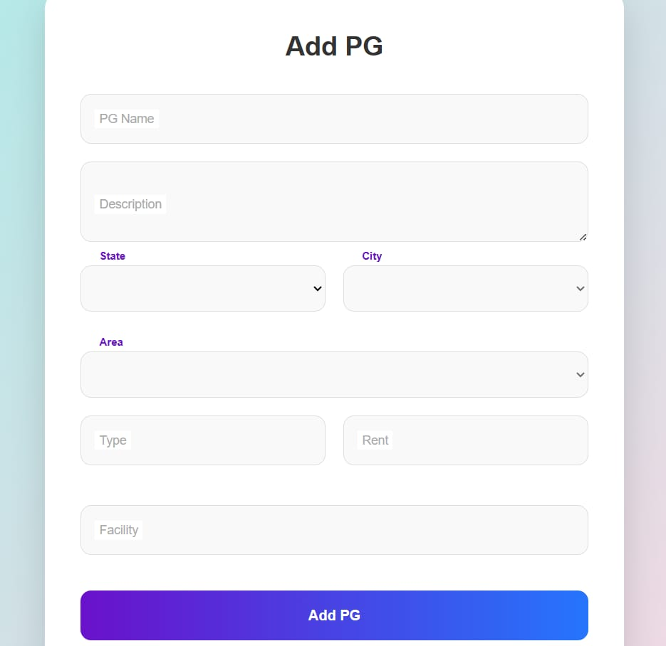
PG Owner Module
The PG Owner module enables property owners to manage their PG and hostel accommodations digitally. It provides tools to add properties, manage rooms, and handle tenant bookings efficiently.
Key Responsibilities
Register and log in as a PG owner
Add and update PG/hostel details
Manage rooms, rent, and facilities
View and confirm tenant booking requests
Track tenant details and rent status
View complaints and ratings

Slide 8
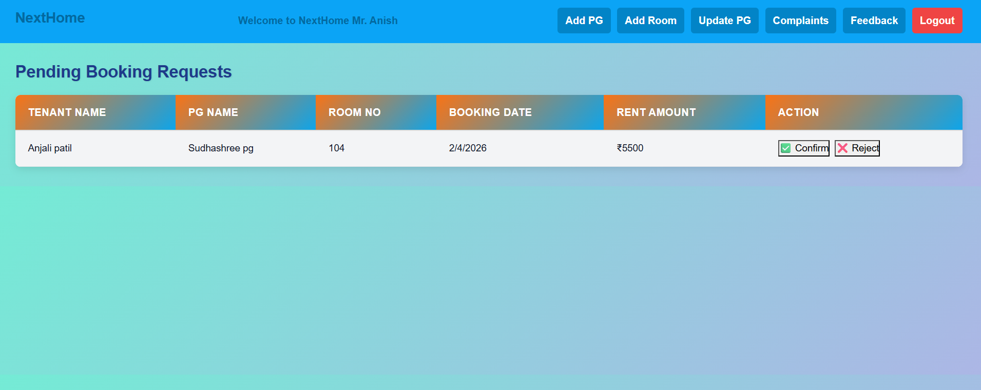
The PG owner can see pending tenant booking requests and has the authority to confirm or reject them.

Slide 9
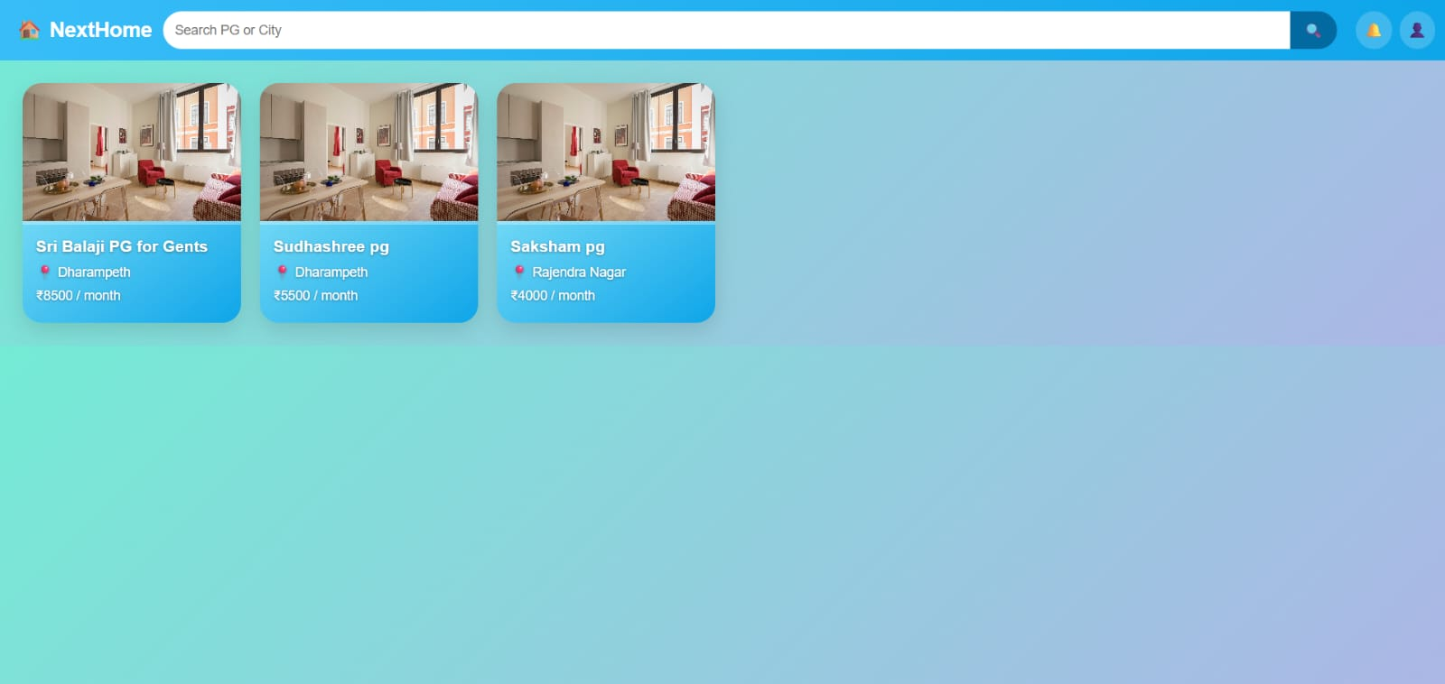
View detailed PG and room information
Tenant Module
The Tenant module is designed for students and working professionals to easily search, book, and manage PG or hostel accommodation through a simple and user-friendly interface.
Key Responsibilities
Register and log in securely
Search PGs and hostels based on location and facilities
View detailed PG and Room Information
Send booking requests to PG Owners
Make Online Payments
Submit Complaints, reviews, and ratings

Slide 10
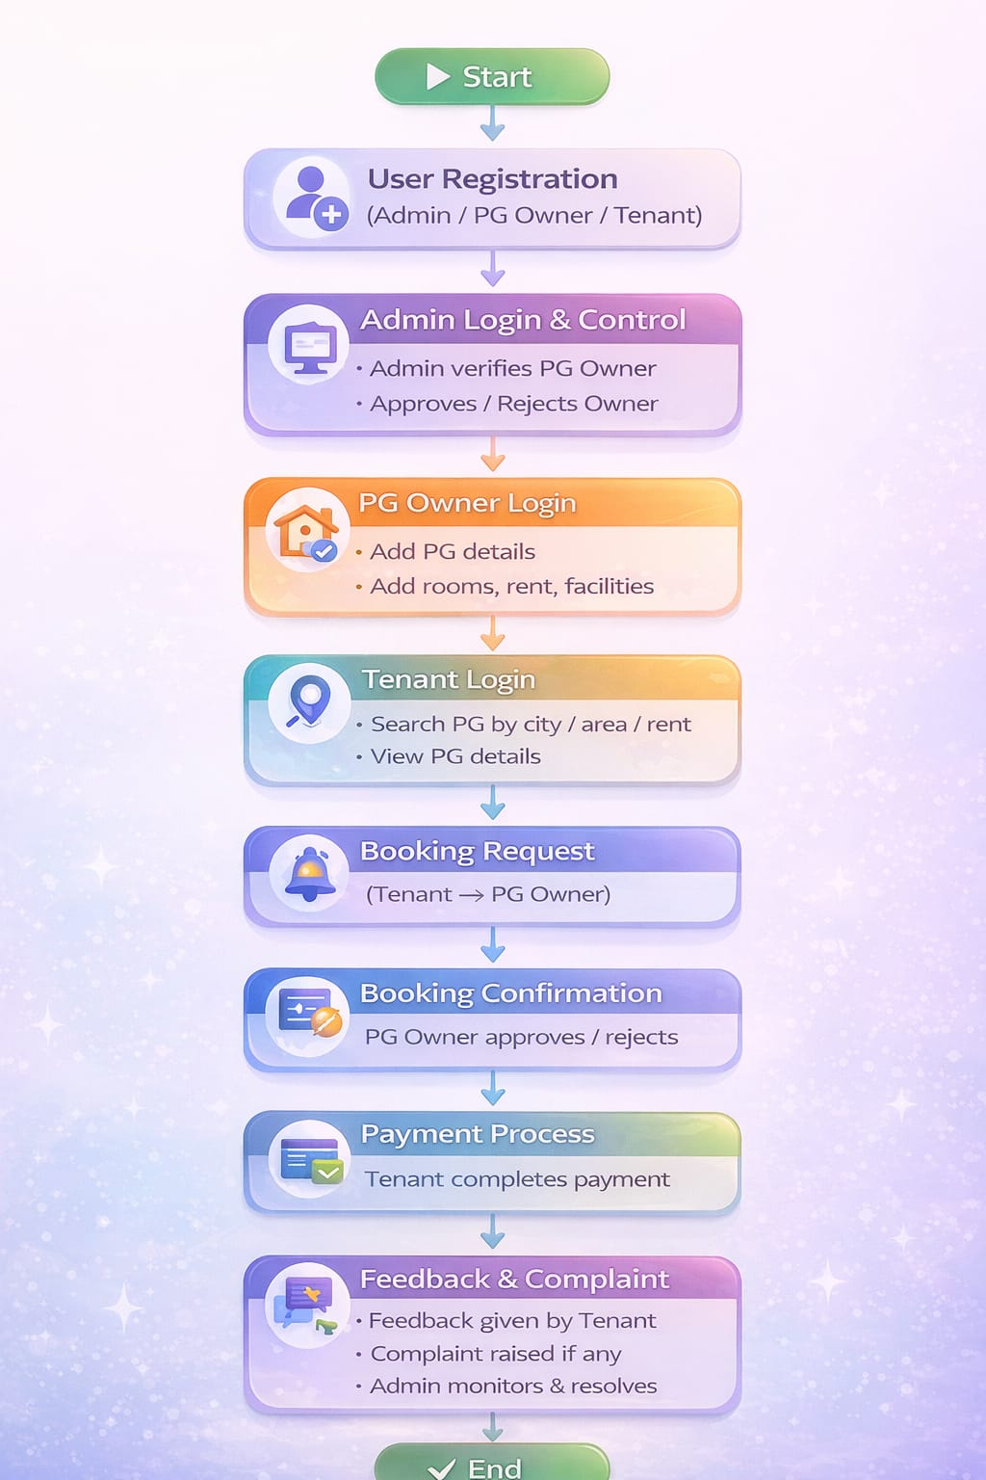
View detailed PG and room information
System WorkFlow
The complete end-to-end workflow of the NextHome system, starting from user registration and PG owner approval to PG search, booking confirmation,
payment processing, and feedback management.
Flow Steps:
PG Owner registers on the platform
Admin verifies and approves the owner
PG Owner adds PG and room details
Tenant registers and logs in
Tenant searches PGs and sends booking request
PG Owner confirms the booking
Tenant completes payment
Tenant provides feedback or raises complaints

Slide 11
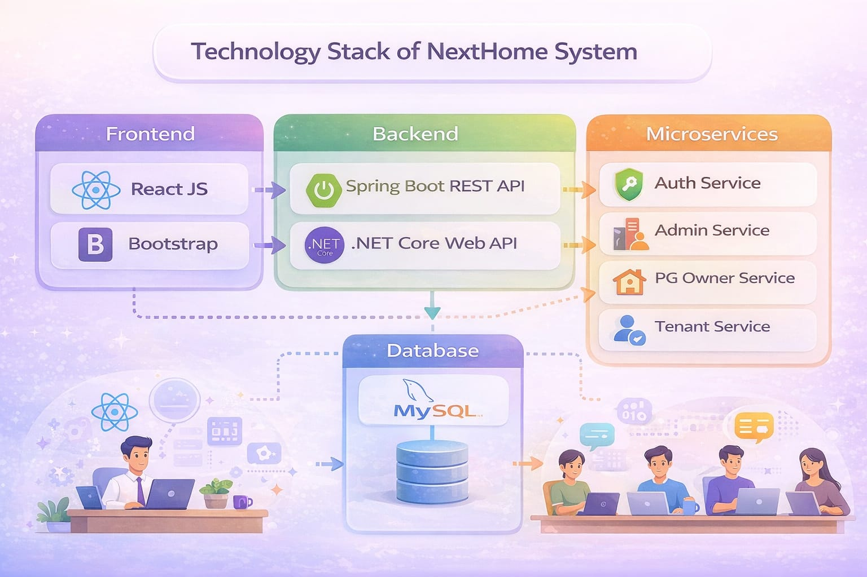
View detailed PG and room information
System Architecture
The NextHome system is designed using a microservices-based architecture to ensure scalability, flexibility, and efficient communication between different system components.
Architecture Components:
Frontend: React JS for user interface , Bootstrap
Backend Services:
Spring Boot REST APIs
.NET Core Web APIs
Architecture Style: Microservices
Database: MySQL
Version Control: GitHub

Slide 12
Database Design
The database is a core component of the NextHome system, responsible for storing, organizing, and managing all
application data securely. It ensures smooth interaction between different system modules and maintains data
consistency across the platform.
Database Entities:
User – Stores login and role information
Admin – Maintains system control and approvals
PG Owner – Stores owner and property details
Tenant – Stores tenant profile and booking data
PG Property – Contains PG and hostel information
Room – Manages room availability and rent
Booking – Tracks booking requests and confirmations
Payment – Stores transaction details
Feedback – Stores ratings and reviews given by tenants
Complaint – Stores issues raised by tenants for resolution

Slide 13
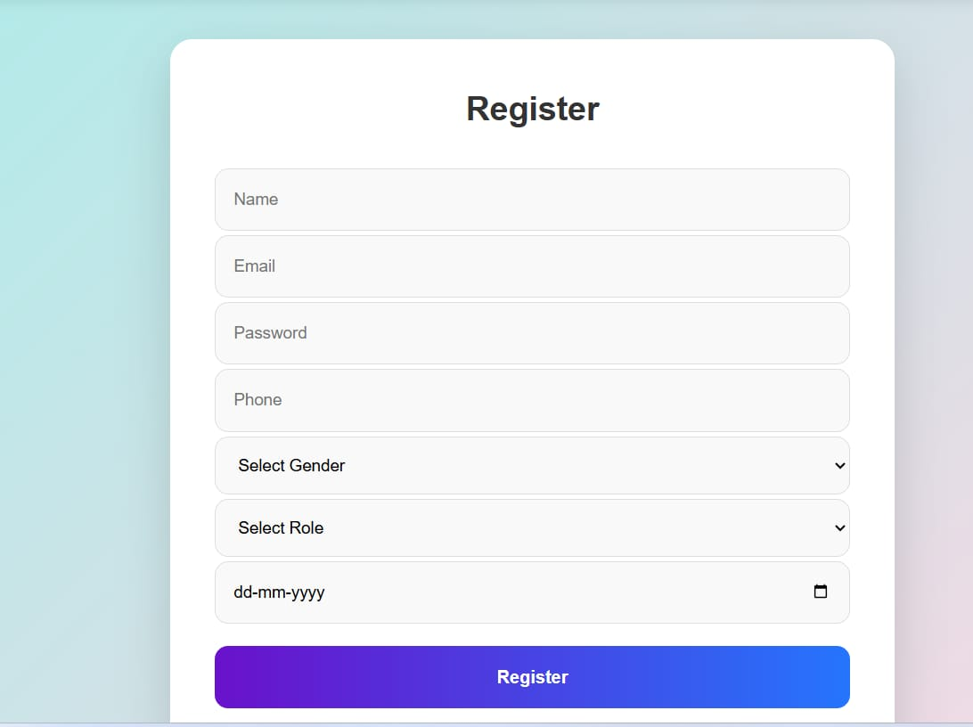
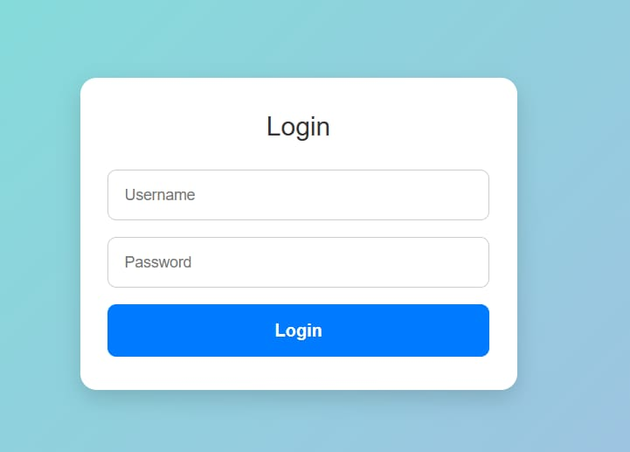
System Screens / Application Demonstration
This slide highlights the key user interfaces of the NextHome application, demonstrating the practical implementation of core
features for different users.

Slide 14
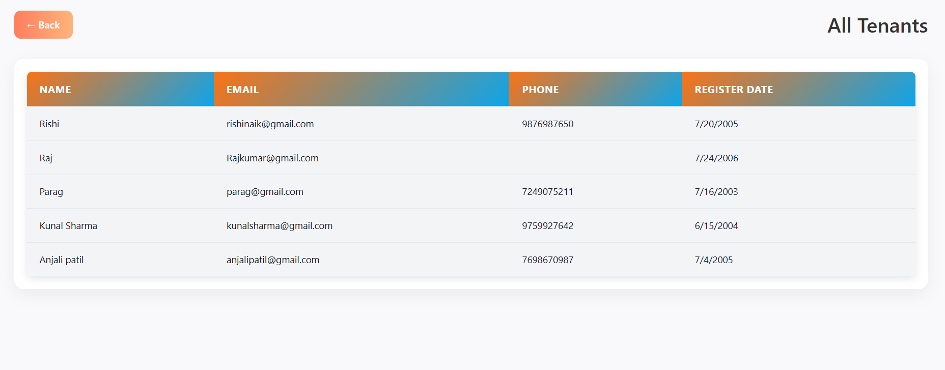
Admin can view all Tenants registered on the platform.

Slide 15
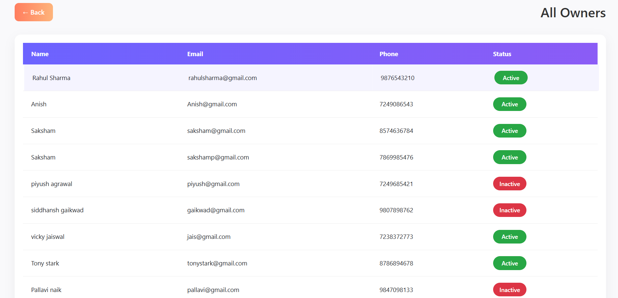
Admin can view all Owners registered on the platform.

Slide 16
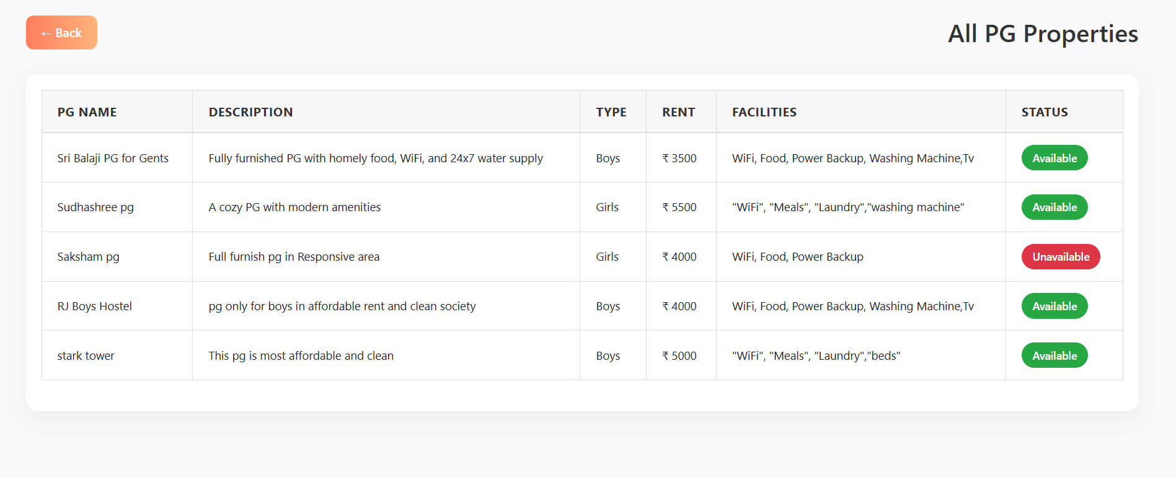
Admin can view Total PG Properties registered on the platform.

Slide 17
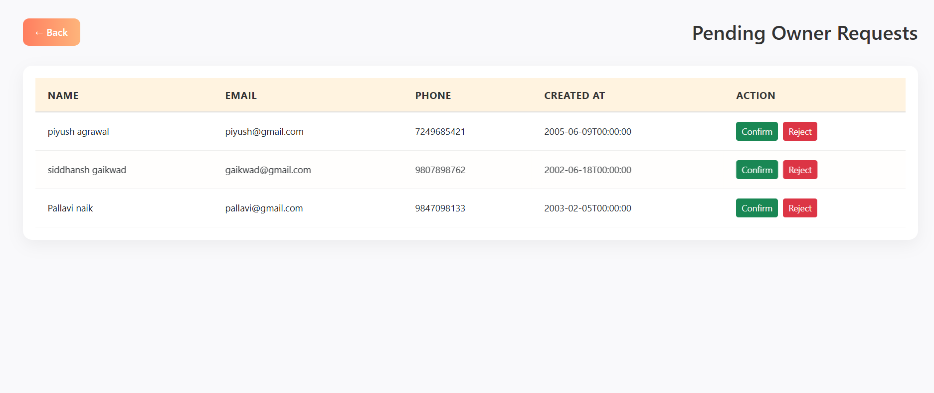
Admin can view Pending Owner Requests registered on the platform.

Slide 18
Future Scope
The NextHome system can be further enhanced by incorporating advanced technologies and additional features to improve usability, scalability, and overall user experience. These enhancements will help the platform adapt to growing user demands and real-world renting challenges.
Proposed Enhancements
Mobile Application for Android and iOS platforms
AI-based PG Recommendations based on user preferences
Map-based Search for location-aware PG discovery
Online Rental Agreement Generation
Real-time Chat between tenants and PG owners
Digital Payment Gateway Integration with multiple options

Slide 19







Key Features at a Glance
Quizzler combines essential functionalities to deliver a comprehensive and engaging platform.
Secure Access
Flexible Quiz Creation
Role-based authentication.
Customizable questions.
Timed Questions
Instant Evaluation
Challenge and engage.
Immediate feedback.
Detailed Explanations
Leaderboard
Enhance learning.
Drive competition.

